Slide 1
EMPLOYEE MANAGEMENT SYSTEM
BY-
SAKSHI BHOYAR (815963) AND H NASREEN SULTHANA(810757)

Slide 2
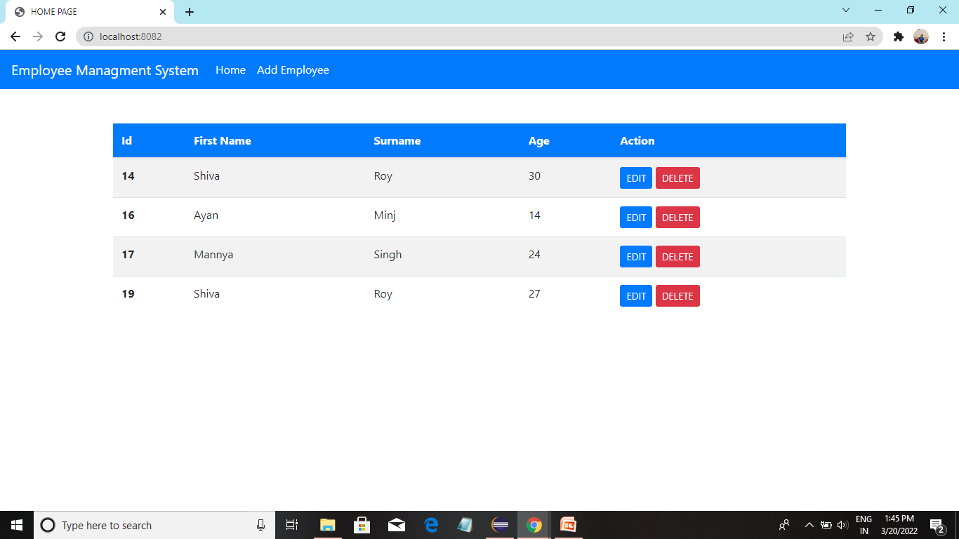
HOME PAGE

Slide 3
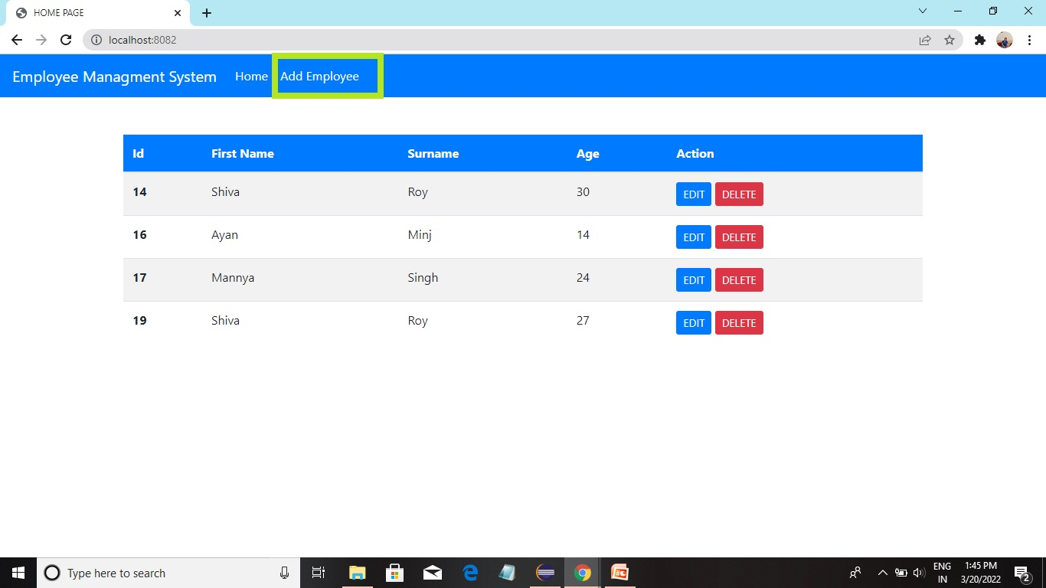

Slide 4
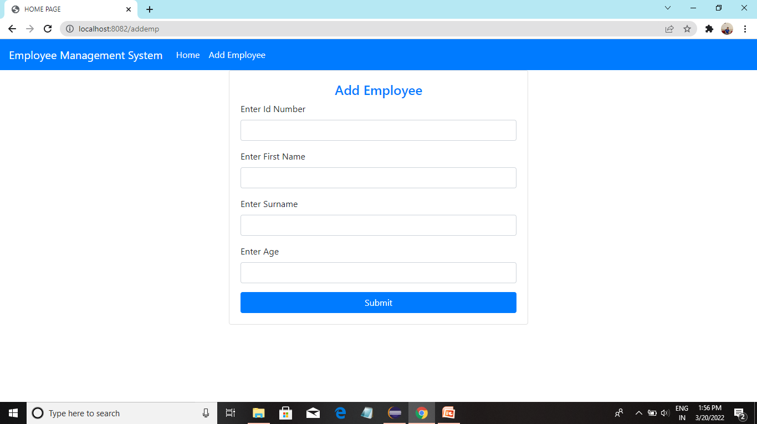
ADDING NEW EMPLOYEE DETAILS

Slide 5
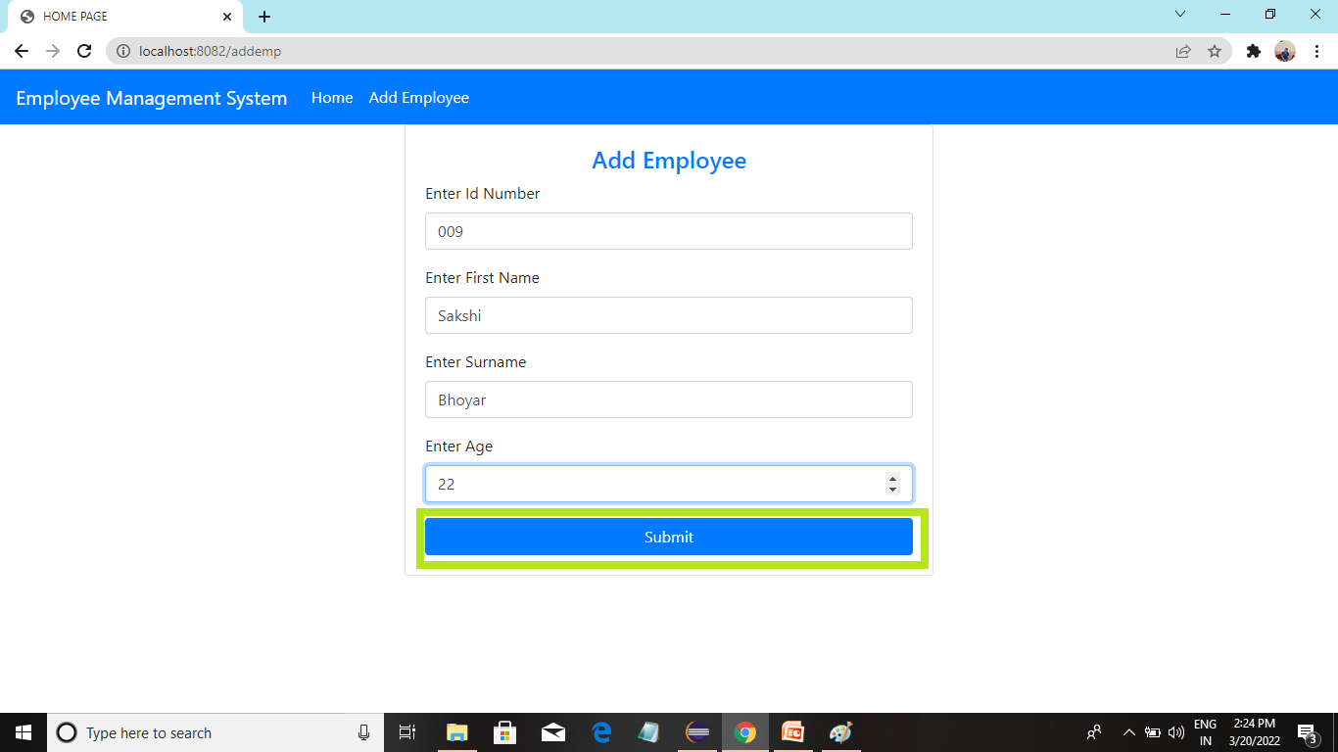

Slide 6
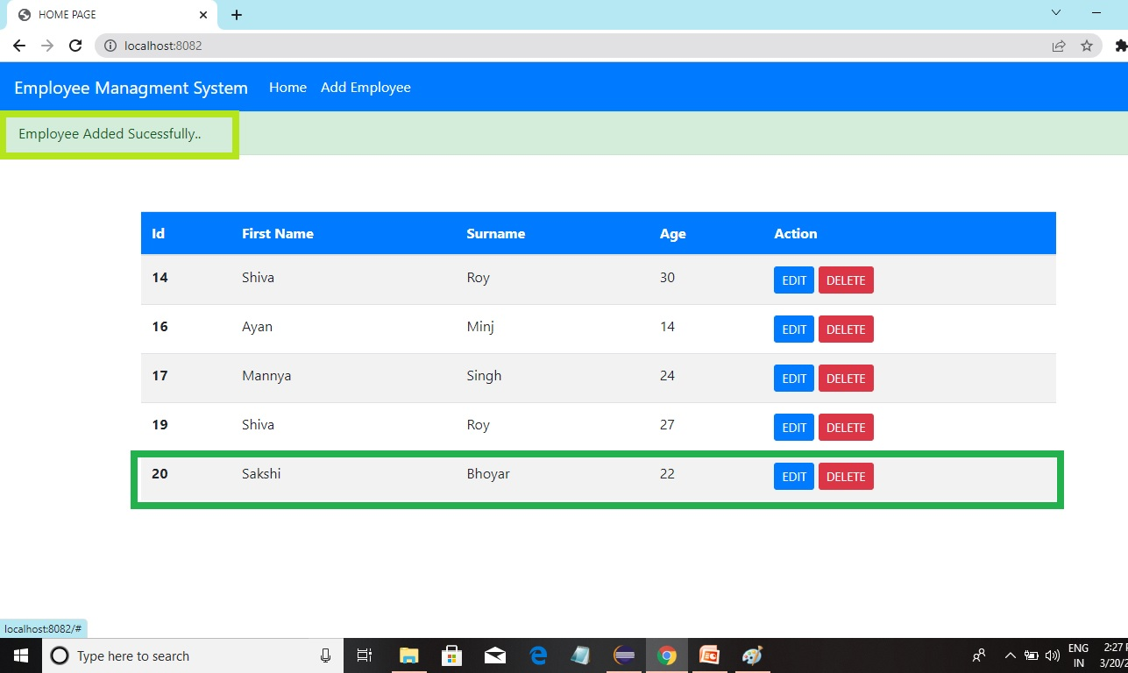

Slide 7
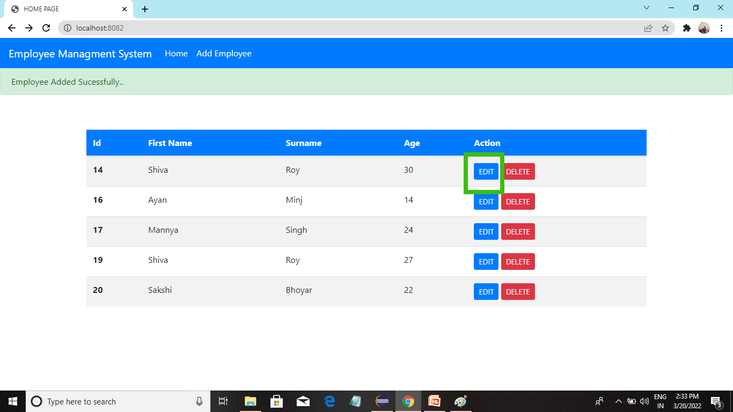
EDITING EMPLOYEE DATA

Slide 8
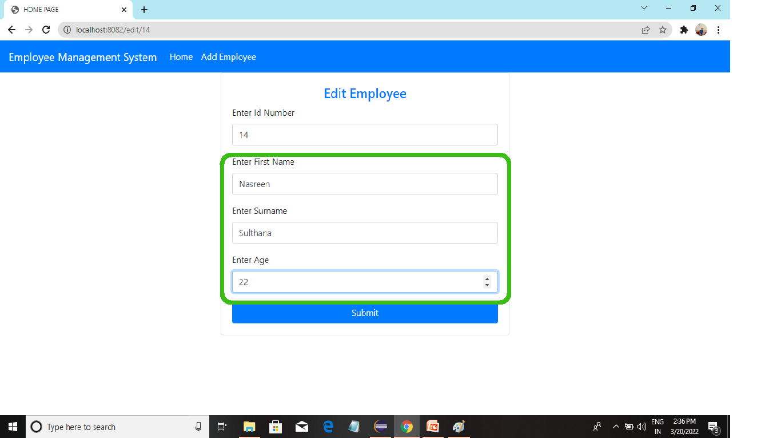

Slide 9
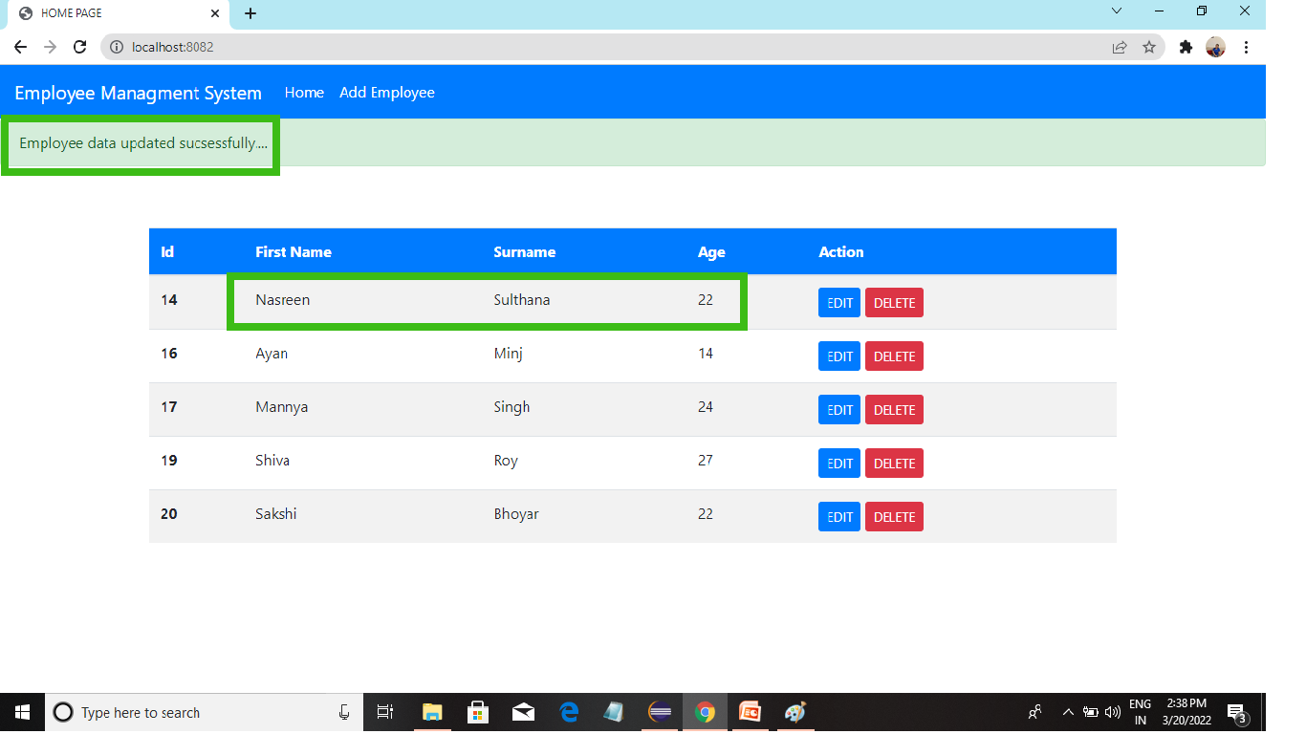

Slide 10
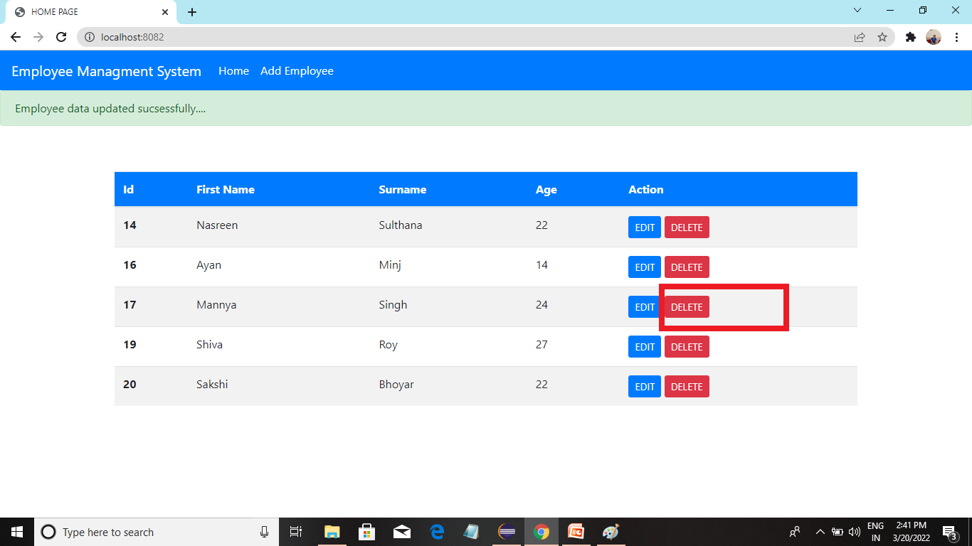
DELETING EMPLOYEE DATA

Slide 11
